Slide 1
Alcohol

Slide 2
Reasons to Drink/Reasons to Abstain
To Drink…..
Not to drink…..

Slide 3
The effects that alcohol have on a person are influence by a number of factors:

Slide 4
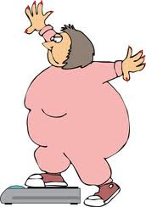
Body Size
The same amount of alcohol has a greater effect on a smaller person than it does on a larger person.

Slide 5
Gender
Alcohol moves faster into the bloodstream in females because males carry more water in their bodies.
Males 61% of your bodyweight is water.
Females 52% of your bodyweight is water.

Slide 6
Time Frame
The consumption of several drinks in a short period of time will cause a person to become intoxicated quicker.

Slide 7
Binge Drinking
The consumption of several drinks in a very short period of time.

Slide 8
Pathway of Alcohol Activity
The Path of Alcohol in the body Mouth: alcohol enters the body.
Stomach: some alcohol gets into the bloodstream in the stomach, but most goes on to the small intestine.
Small Intestine: alcohol enters the bloodstream through the walls of the small intestine.
Heart: pumps alcohol throughout the body.
Brain: alcohol reaches the brain.
Liver: alcohol is oxidized by the liver at a rate of about 0.5 oz per hour.
Alcohol is converted into water, carbon dioxide and energy.

Slide 9
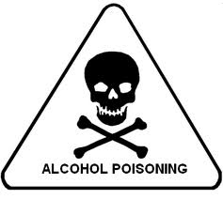
Amount
A large quantity of alcohol causes the levels in the bloodstream to rise quickly.
If it becomes to high, alcohol poisoning can occur.

Slide 10
Food
Food slows down(absorbs) the passage of alcohol into the bloodstream.

Slide 11
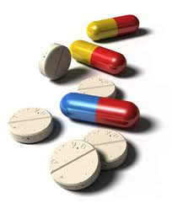
Medicine
Mixing alcohol with prescription or non-prescription drugs will intensify the effects of alcohol.
Interactions between the two substances can cause potentially very serious medical consequences.

Slide 12
Alcohol Terms to Know:
Blood Alcohol Concentration (BAC):
The amount of alcohol present in a person’s bloodstream.

Slide 13
Breathalyzer:
A device used to estimate BAC from a breath sample.

Slide 14
Intoxicated
Physically and/or mentally impaired from the consumption of alcohol.
For anyone Under 21:
BAC above 0 is illegal
For anyone Over 21:
.08 is considered intoxicated

Slide 15
DWI
DWI: Driving while intoxicated. DWI’s are issued to those who are driving above the legal limit. (.08)
BAC levels of .08 or higher are considered evidence of intoxication.
BAC levels of .18 or higher are considered Aggravated DWI.
BAC levels of .05 to .07 are considered DWAI (Driving While Ability Impaired) and can be classified as caused by alcohol, other drugs, or a combination.
New York state also has a Zero Tolerance Law for drivers under the age of 21.

Slide 16
DUI: Driving under the influence.
DUI’s are issued when a driver is on drugs that impair their ability to operate the vehicle safely. (narcotics, prescriptions drugs, etc).

Slide 17
Fetal Alcohol Syndrome
Fetal alcohol syndrome (FAS) is a condition that results from alcohol exposure during pregnancy. Problems that may be caused by fetal alcohol syndrome include physical deformities, mental retardation, learning disorders, vision difficulties and behavioral problems.

Slide 18
Short Term Effects of Alcohol
Slurs speech
Impairs reflexes and reaction time
Impairs judgement
Increases frequency of urination
Causes nausea and vomiting
May cause anger, violence, or mood swings
Relaxes the eye muscles, making it difficult to focus

Slide 19
Long Term Effects of Alcohol
Causes liver damage
Causes heart disease
Causes irreversible brain and nerve damage
Causes cancer of the stomach
Causes malnutrition
Causes diseases of the stomach, digestive system, and pancreas
Results in a vitamin deficiency

